Slide 1

Shri Vaishnav Vidyapeeth Vishwavidyalaya
Made by: Bhavansh Sthapak (18100BTCSAII02859) Rohan Yadav (18100BTCSAII02859)
Submitted to: Mr. Gaurav Thulla

Slide 2
Video Game Hits Prediction

Slide 3
Why this project ?
There are now more than 2.5 billion gamers across the world. Combined, they will spend $152.1 billion on games in 2020, representing an increase of +9.6% year on year. Console will be the fastest-growing segment this year, growing +13.4% year on year to $47.9 billion in 2020.
The video games market could become a $300 billion industry by 2025, with the growth of mobile gaming and offerings like cloud gaming.
We also like games !!

Slide 4
Overview of the project
In this project, We analyse sales data from many video games ( approx. 10k ), identify variables most correlated to hits (games which sell over 1M units) and using that we implement a prediction model to separate winners from losers.
This includes both – data visualization of important aspects related to video games sales over the years with respect to many features like the current gaming platforms and their earned scores from different popular websites, etc. and the second part is prediction of success for any newly announced game via machine learning.

Slide 5
Data exploration and analysis
In first part we will take a glance at how game sales vary according to critic scores, which are split into different scoring groups via different visualization techniques that segments the data further by features like genre, developer, publisher, and platform.
we identify the categories where games sell best. This is done for okay, good, and great games, as defined by games with scores in higher markings like 70s, 80s, and 90s, respectively.

Slide 6
Prediction model
For predicting the likelihood of a given game to reach sales of 1 million units or higher, referred to as “hit” games. Classification approach is applied to separate hits from non-hits.
Given their hype and other factors like the corresponding popularity of the creators, through our prediction model which future video games can become hits?

Slide 7
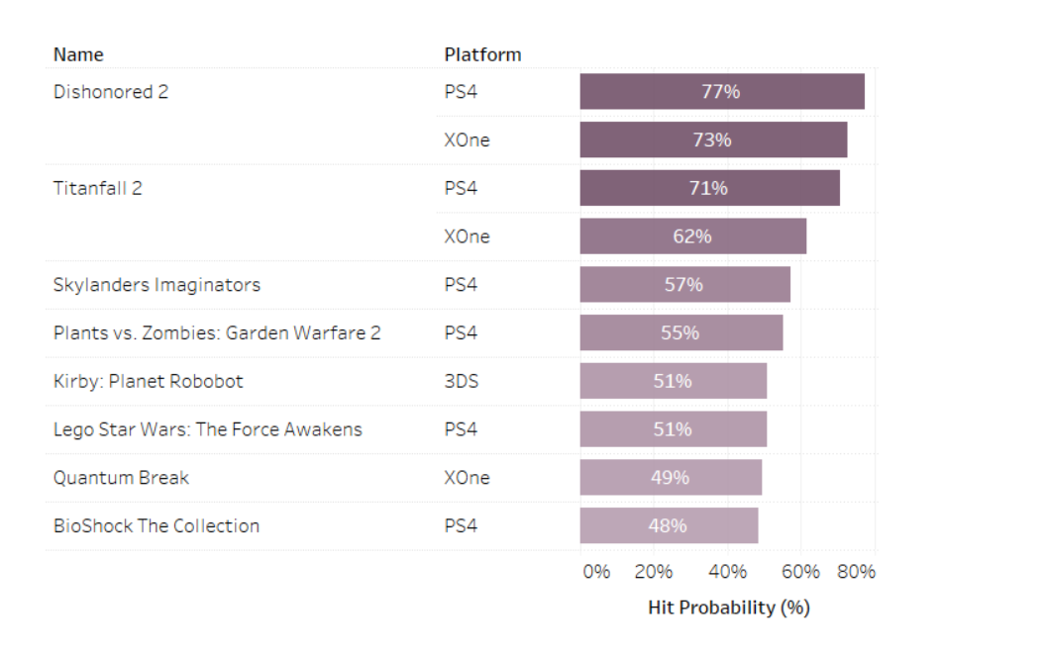
Expected Output -

Slide 9
Thank You !!

